Slide 1

Online tutoring: scientific evidence from Italy
Michela Carlana, Harvard University and J-PAL
March 12th, 2024
Closing educational gaps from the UC: the tutoring experience

Slide 2
Motivation
COVID-19 & learning loss
School closure due to COVID-19 outbreak has exacerbated concerns about inequalities in education outcomes
  Learning losses for children: 0.17 SD, equivalent to approximately one-half year’s worth of learning (Patrinos et al., 2022, Carlana et al., 2023)
  Adverse psychological effects (Orgilés et al, 2020; Golberstein et al, 2020)
Tutoring programs are currently promoted across the world to accelerate student learning and compensate for interrupted instruction due to COVID-19

Slide 3
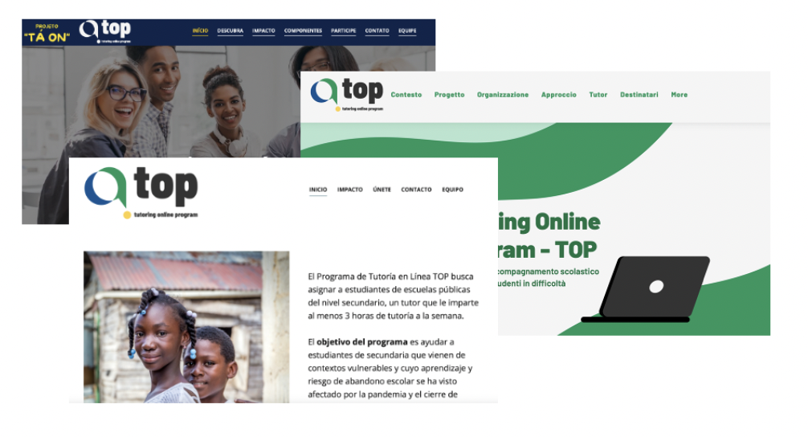
Tutoring Online Program
Evaluate the impact of an innovative Tutoring Online Program (TOP) launched in Italy in 2020 and scaled up/expanded in subsequent years impacting more than 4,000 disadvantaged students

Slide 4
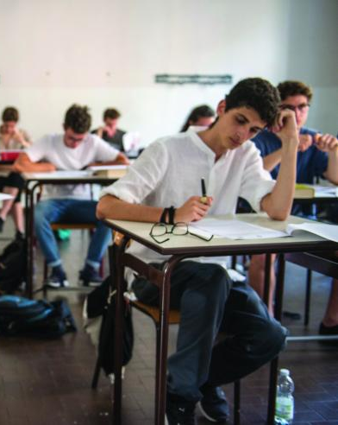



Tutoring Online Program
  TOP (“Tutoring Online Program”) was created in March 2020 to help children during school closure with the support of an online tutor
  Students in grades 6-8 from disadvantaged backgrounds (socio-economic status, language barriers, learning difficulties, ...)
  Causal evaluation: Results from the pilot show promising impact on achievements, socio-emotional skills, psychological well-being, and aspirations.
Foto : Stefano Guidi | Shutterstock.com

Slide 5
Tutoring Online Program
In-person tutoring is highly effective (Nickow et al, 2020; Fryer Jr., 2017; Banerjee et al, 2015), but TOP has two defining features:
  Tutoring entirely online: In-person interaction not possible during lockdown
  Tutors are volunteer university students, trained and supported by pedagogical experts
    Low cost compared to hiring professionals
    Quality of inter-personal interaction: intrinsic motivation of volunteers and closer relationship tutor-tutee

Slide 6
Program Description
Individual online tutoring
3-6 hours support per week in doing homework assigned by students’ own teachers in Math, Italian or English → no “extra” materials
  Math covered by 78% of students

Slide 7
Program Timeline and Description
March 5th
School closure
April-May
TOP Intervention
June
Endline Surveys to parents, children, and teachers
March 30th
TOP Schools recruitment
By April 15th
Baseline Surveys & Randomization
April 3rd
TOP Tutors recruitment
Email sent to public list of all Italian middle schools
Schools select max 3 students per class who need the program the most, in terms of their learning level and family environment
Indicate subjects of tutoring: (1) Math; (2) Italian; (3) English

Slide 8
Program Timeline and Description
March 5th, 2020
School closure
April-May
TOP Intervention
June
Endline Surveys to parents, children, and teachers
March
TOP Schools recruitment
April
Baseline Surveys & Randomization
March
TOP Tutors recruitment
Email sent by dean of Bocconi, Bicocca & State University of Milan to all enrolled students
Can choose to tutor in 1 or more of the 3 subject areas
Training resources and support are offered on a voluntary basis by pedagogical experts of Bicocca University, including self-training course and counseling during the entire program (group+individual)

Slide 9
Program Timeline and Description
March 5th
School closure
April-May
TOP Intervention
June
Endline Surveys to parents, children, and teachers
March
TOP Schools recruitment
April
Baseline Surveys & Randomization
March
TOP Tutors recruitment
More than 1,000 parents+students completed the baseline survey
Due to Budget/administrative capacity, we randomly assigned students to a tutors
Tutors were randomly assigned to a students if excess availability in subject, time slot, and experience

Slide 10
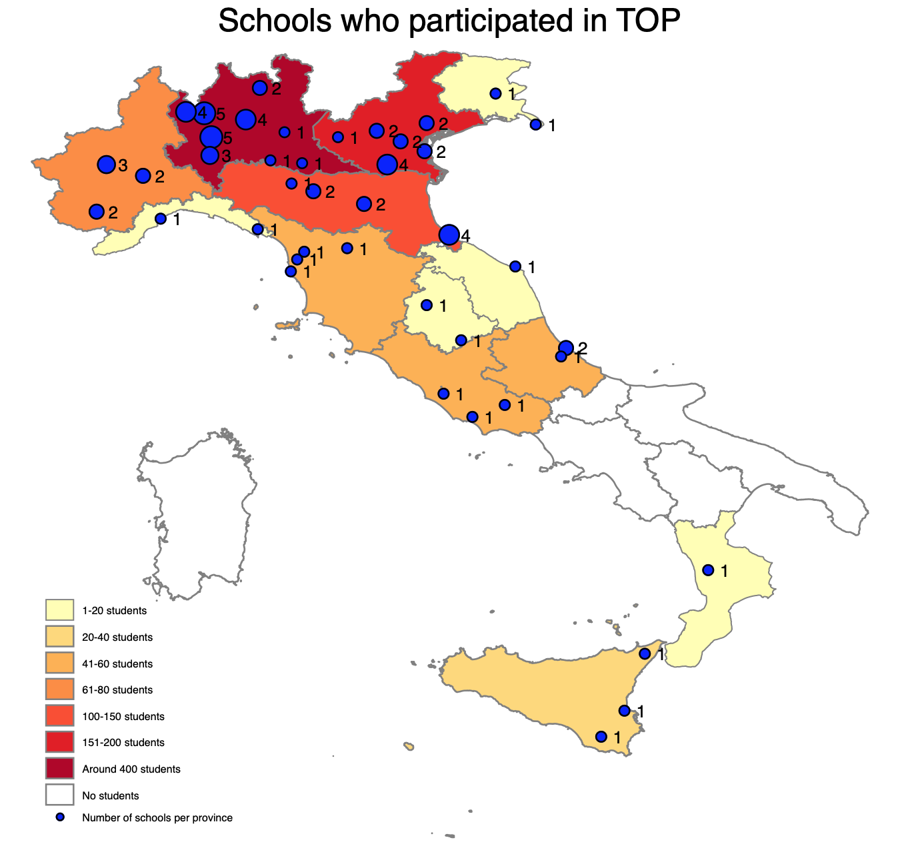
Sample
Students: 1059 in 2020 and 2522 in 2022 applications from families selected by the school teachers.
Tutors: in 2020 523 volunteer university students (selected among around 2,000 applicants), 778 in 2022 .

Slide 11
Endline Questionnaires & Administrative Outcomes
Academic Outcomes & Beliefs
  Test Score
  Beliefs on # correct questions from students, parents, teachers
  Grades from teachers; beliefs on grades from students and parents
Aspirations: goals and self-efficacy
Socio-emotional skills
  Perseverance: logic task, possibility to choose difficult/easy/give up
  Grit (Duckworth scale)
  Locus of control
Well-being
  Happiness scale
  Children's Depression Screener (ChilD-S) (Fruhe et al., 2011)

Slide 12
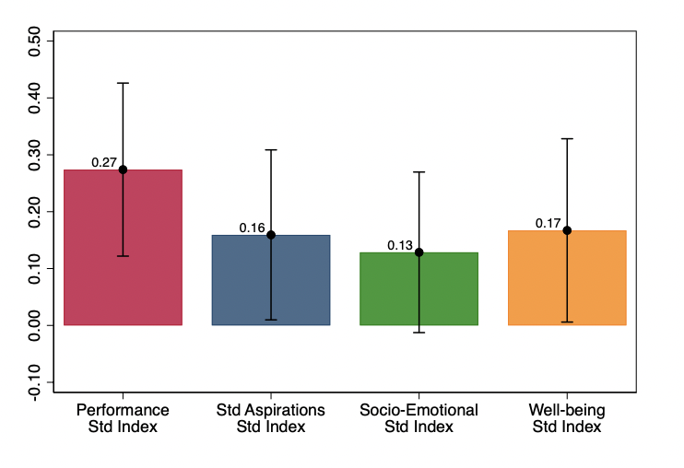
Main results on aggregate indexes in 2020

Slide 13
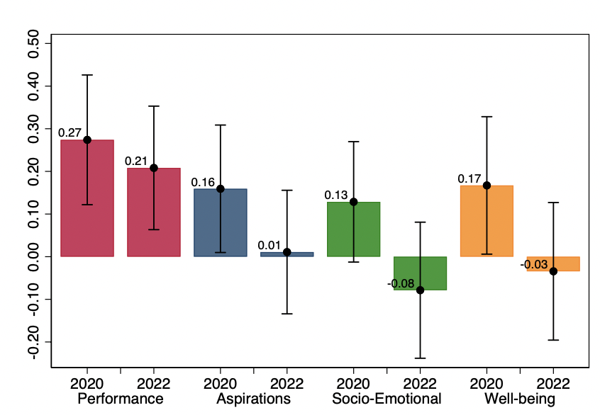
Main results on aggregate indexes in 2020 vs. 2022

Slide 14
Other key results
Performance almost doubled with 6h per week vs. 3h
No heterogeneous impact on other dimension
Group vs. Individual Tutoring
The effect of individual tutoring is more than double on performance compared to group tutoring (2 students)
Intensity of the tutoring

Slide 15
Heterogeneity: Student and Tutor characteristics
Students. Overall, limited heterogeneity but:
  More positive impact on performance for students with learning disorders
  More positive impact on well-being for immigrant students compared to natives
Tutors: do not detect economically nor statistically significant differences considering several dimensions, including the gender match.
  All university students intrinsically motivated can be great tutors!
The results are similar using interaction in the regression or the causal forest algorithm (Athey and Imbens, 2016),

Slide 16
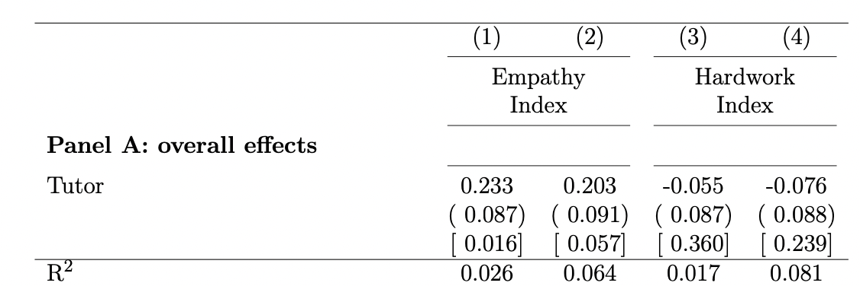
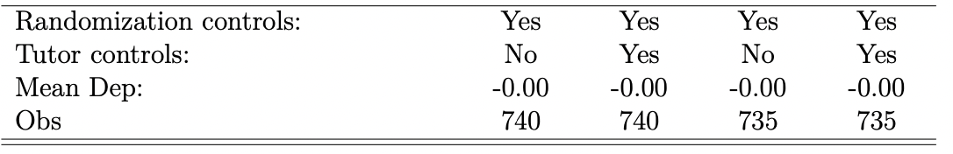
How did TOP affect university students?
Assignment of tutors to students was random, conditional on baseline characteristics used for allocation (subject, time availability, and experience)

Slide 17
Conclusion and Future Directions
Online tutoring provided by volunteer university students can be a simple and cost-effective intervention to mitigate inequalities in education.
  We find a positive impact not only on academic performance (+0.26 sd), but also on well-being, aspirations, and socio-emotional skills.
Advantages not only for COVID-19:
  Reach remote locations
  Supply of qualified tutors, possibly from other regions (exposure to other environments)
  Highly cost-effective
Potential limitations: Internet access and Technology +tutors’ recruitment

Slide 18
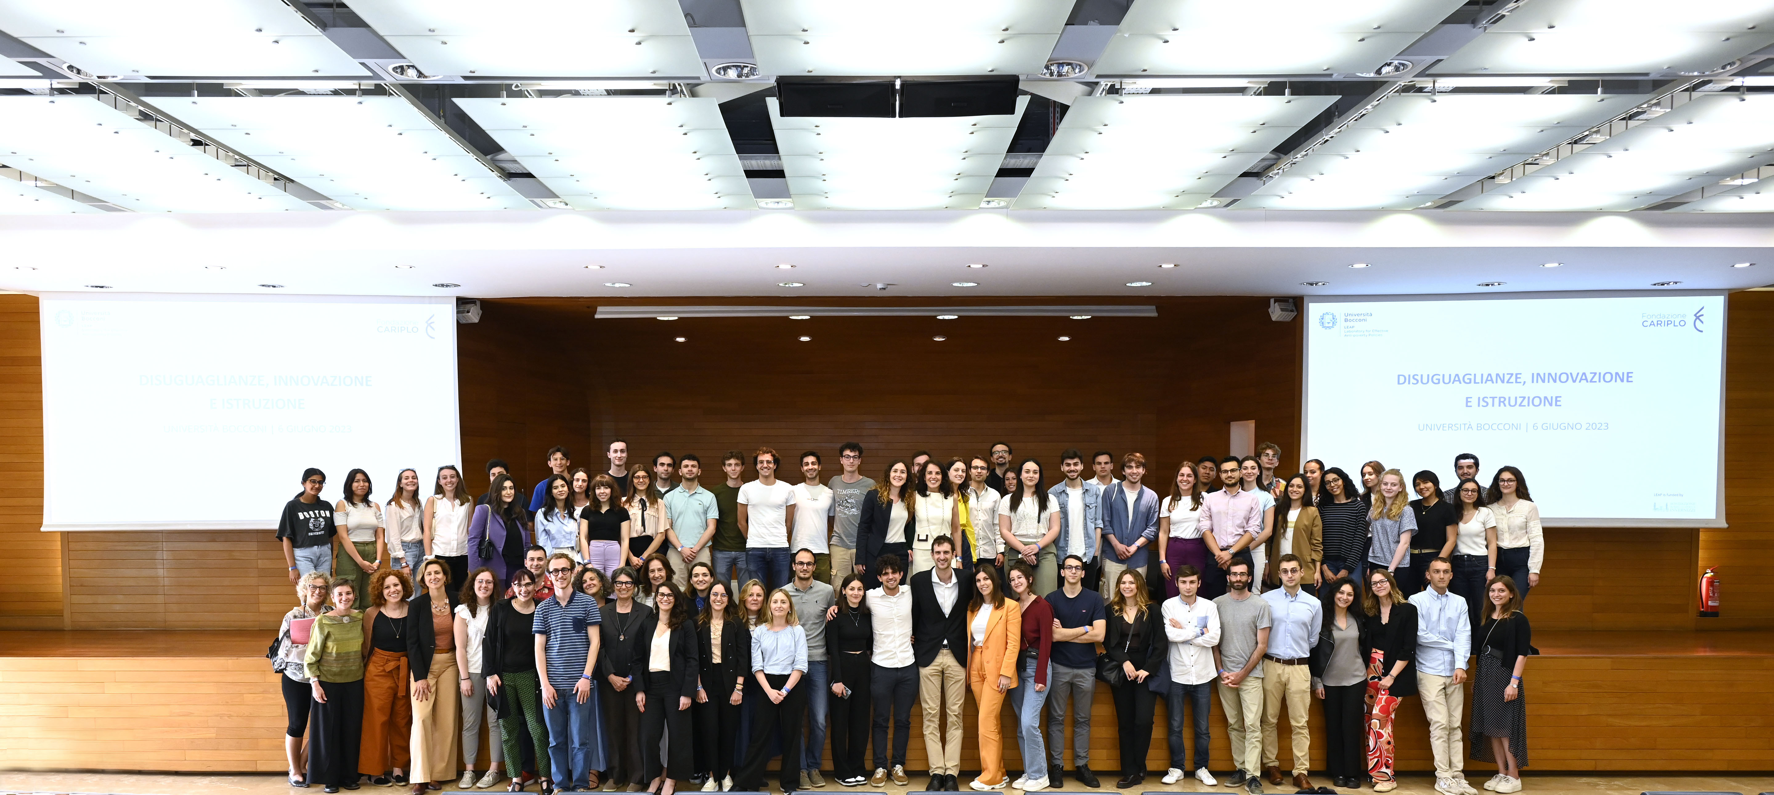
Thank you
Michela_carlana@hks.harvard.edu

Slide 19
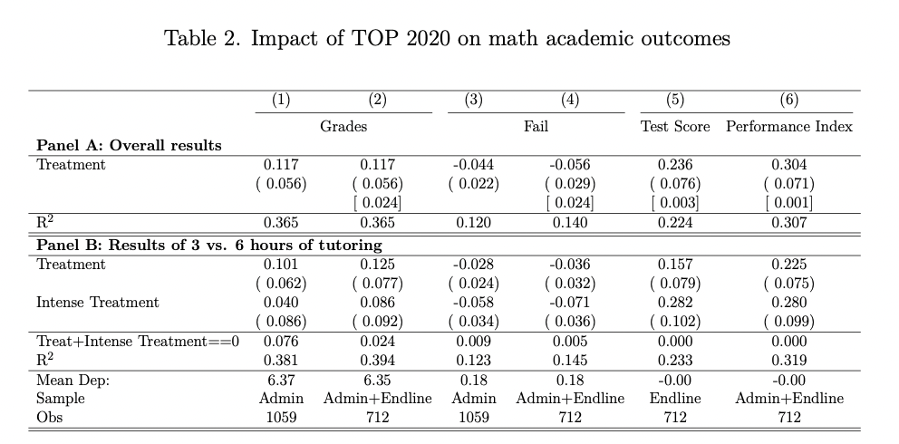

Slide 20
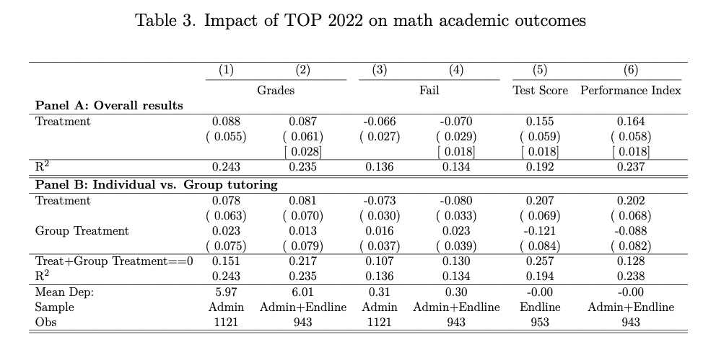

Slide 21
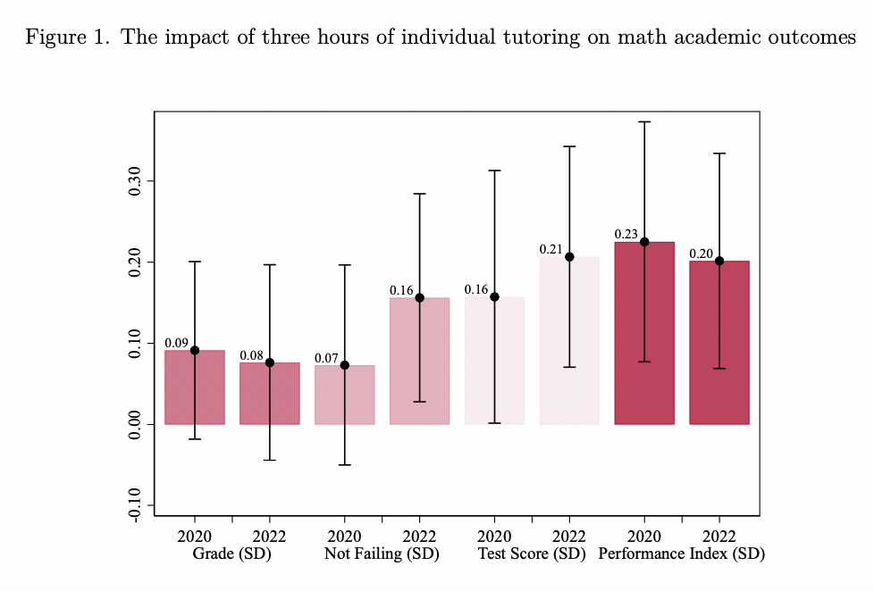

Slide 22
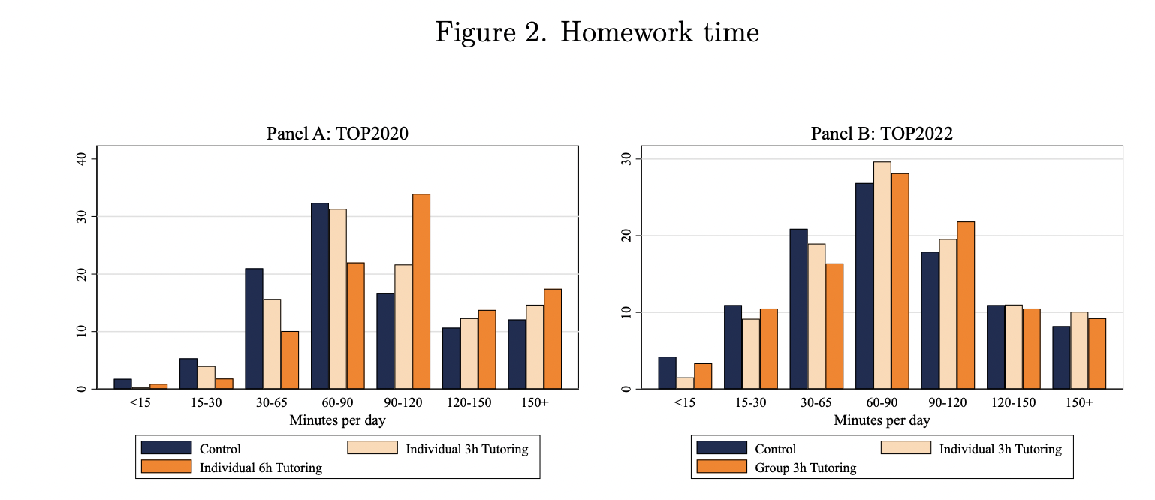

Slide 23
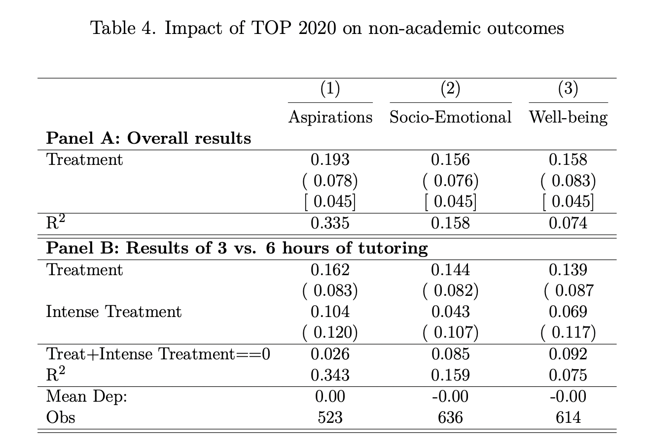

Slide 24
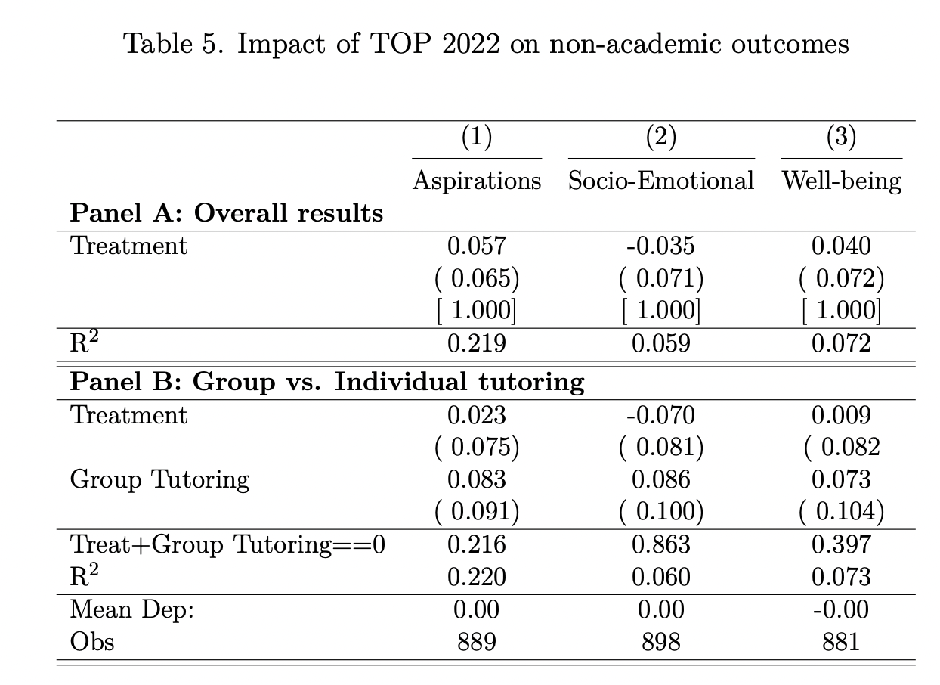

Slide 25
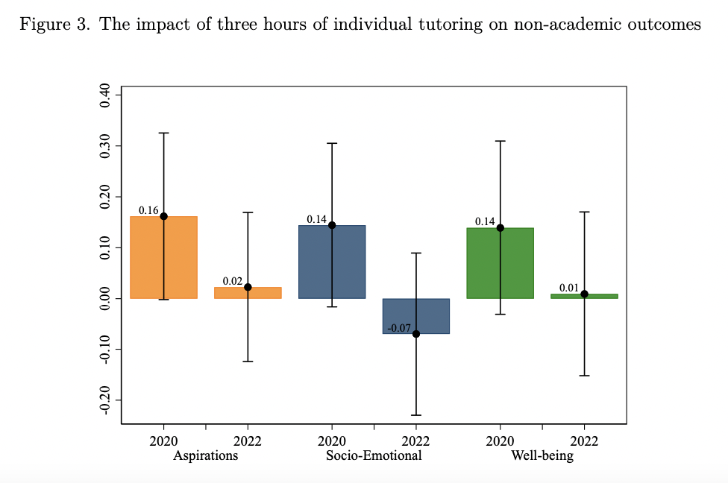

Slide 26
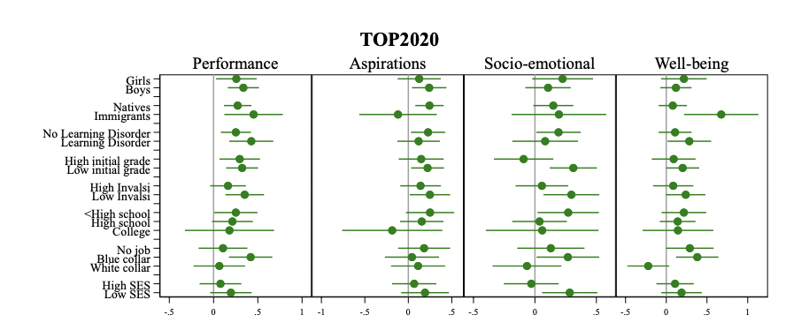

Slide 27
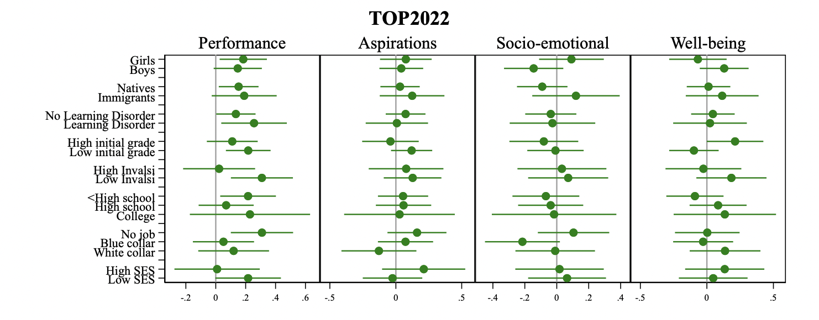

Slide 28
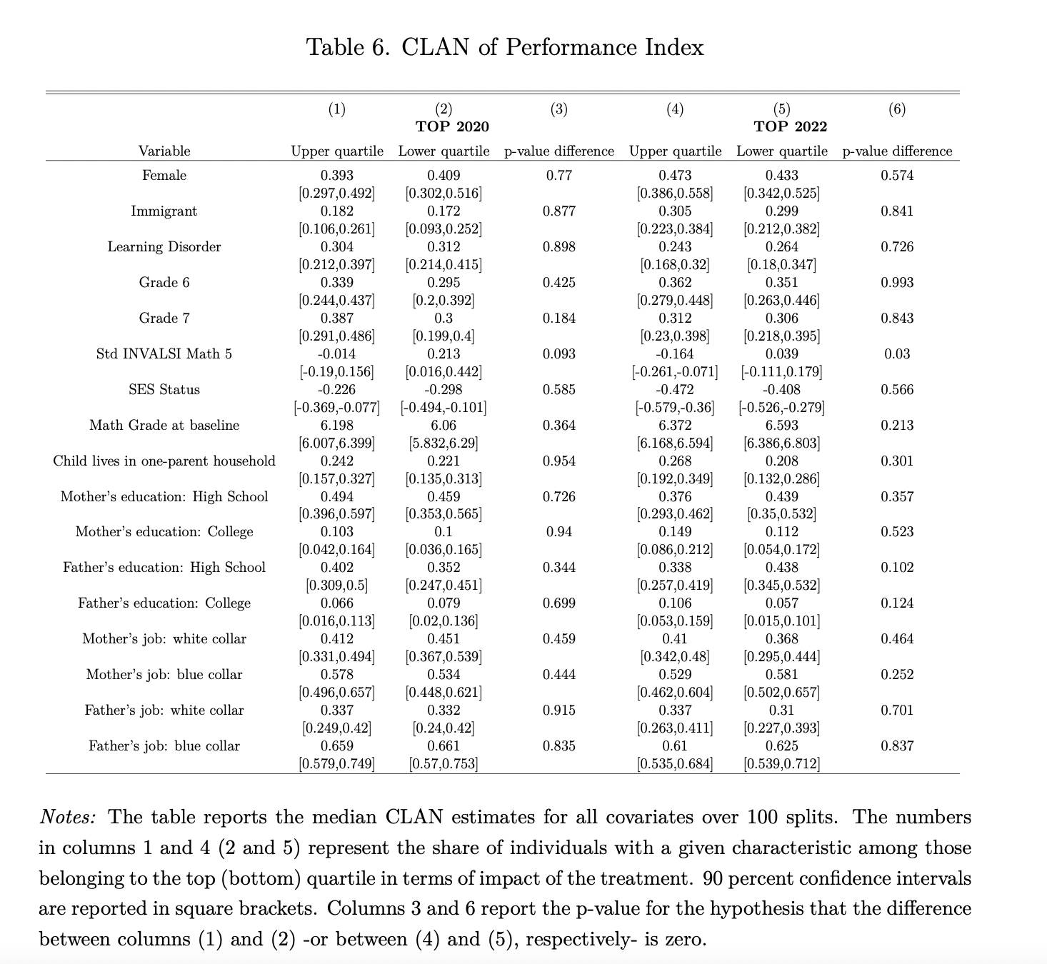

Slide 29
